Slide 1

E-Commerce Laptop Analysis and Segmentation using ML
Vidhu Govind

Slide 2

Objective
Web scrapping and Data Storing
EDA
Unsupervised and Supervised Learning m

Slide 3
DATA
Data scrapped from Flipkart(laptops)
250 rows
Using web scrapping
Saved into excel-csv files
New features added from names using split
Cleaned
158 rows after removing duplicates and handling null
Uploaded and saved in an SQL database

Slide 4
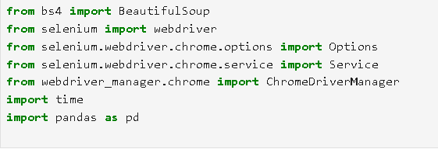
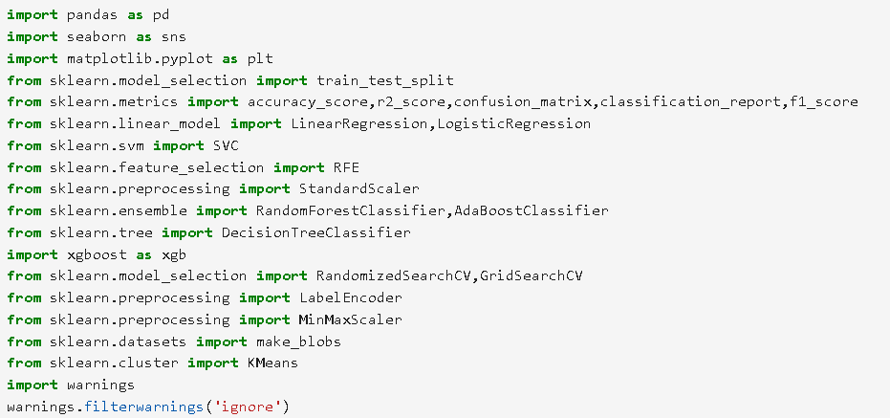
TOOLS &LIBRARIES

Slide 5

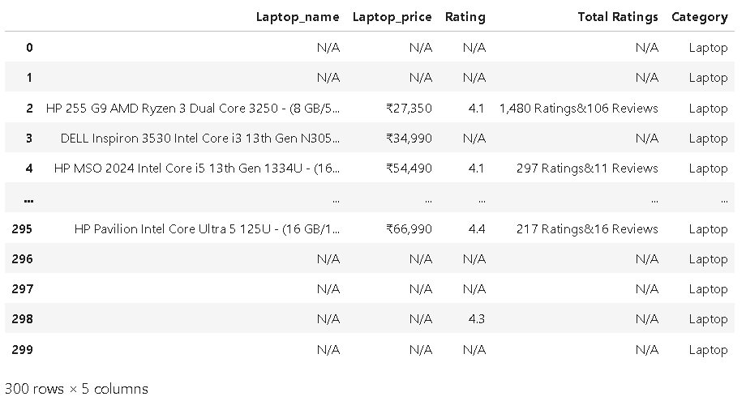
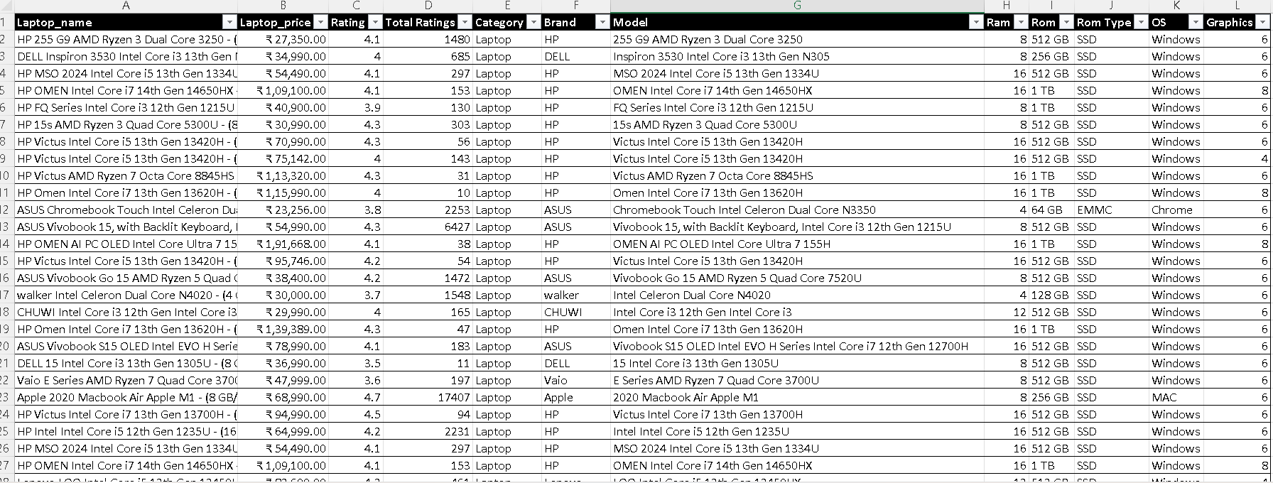
WEB SCRAPPING

Slide 6
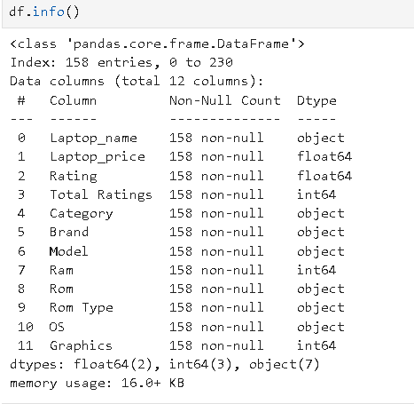
FINAL DATA

Slide 7
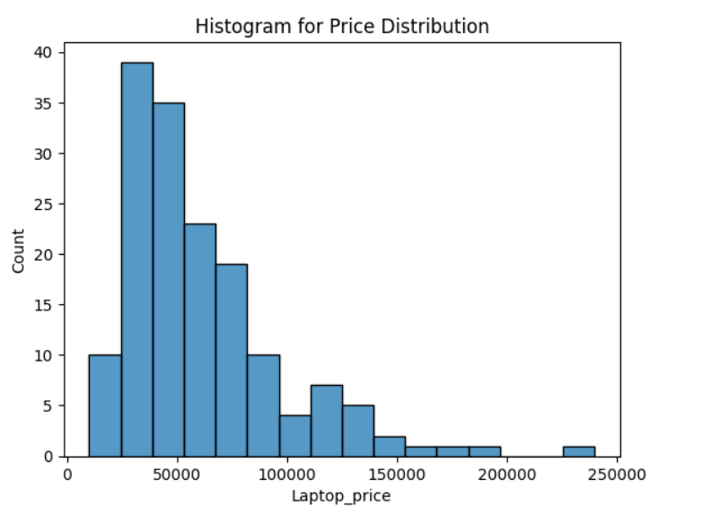
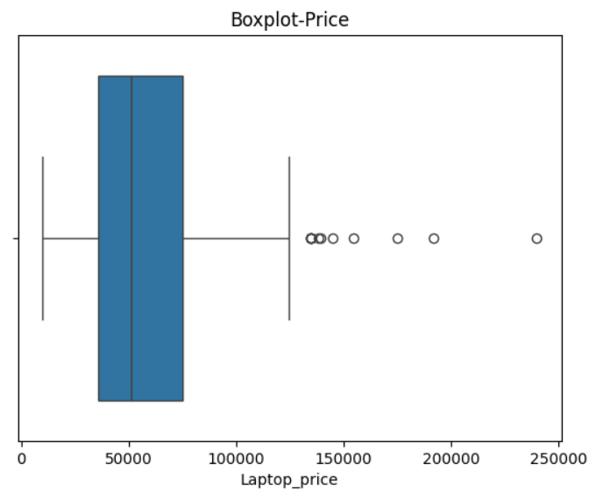
PRICE DISTRIBUTION

Slide 8
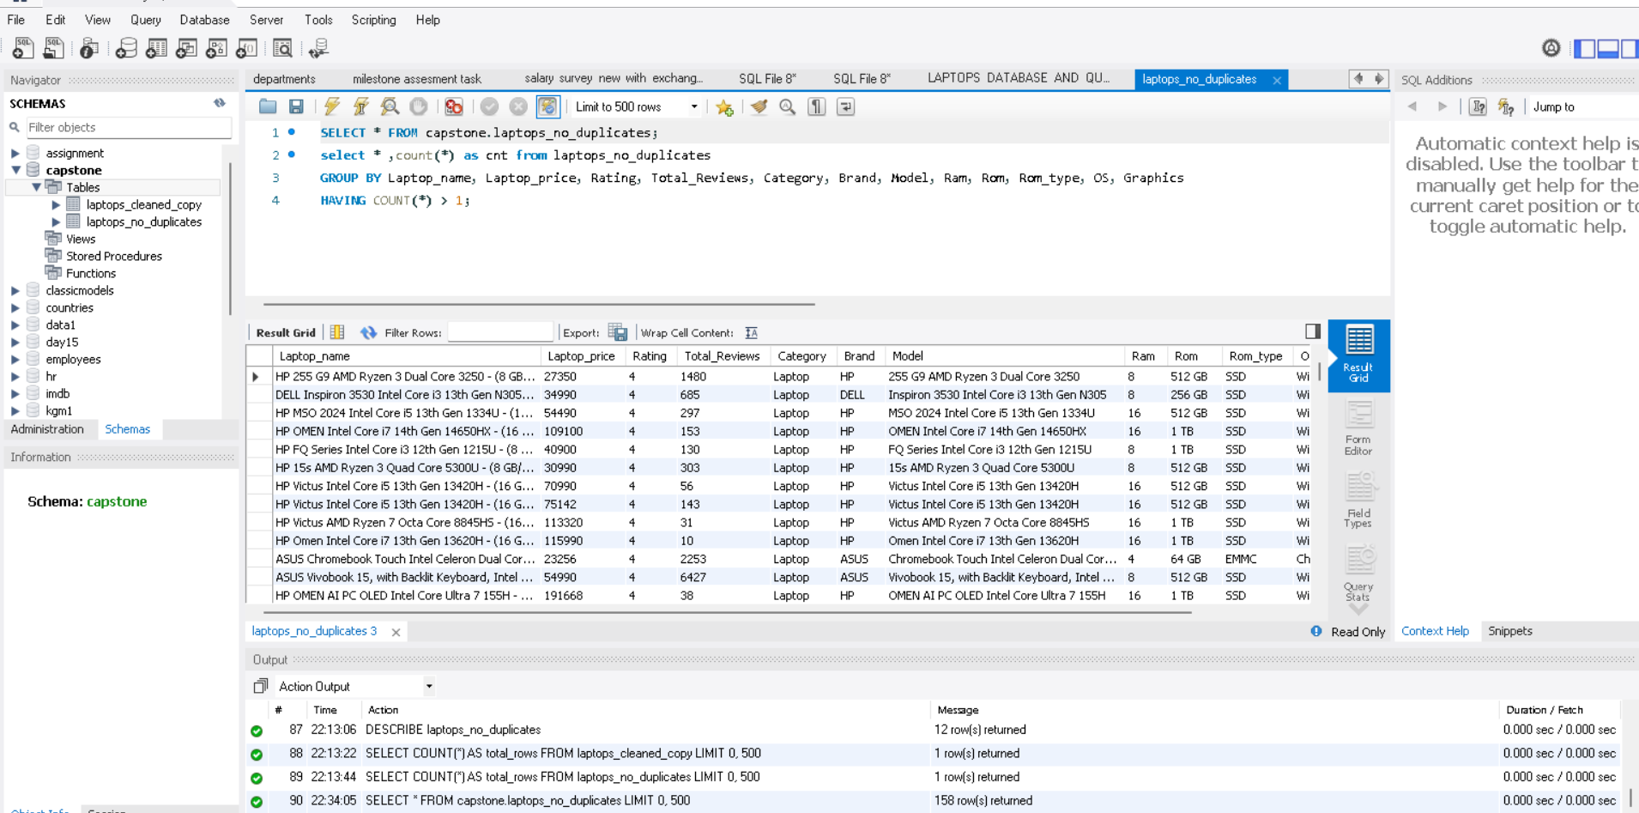
STORING
CLEANED DATA IS STORED IN SQL DATABASE-CAPSTONE
DUPLICATES WERE REMOVED

Slide 9
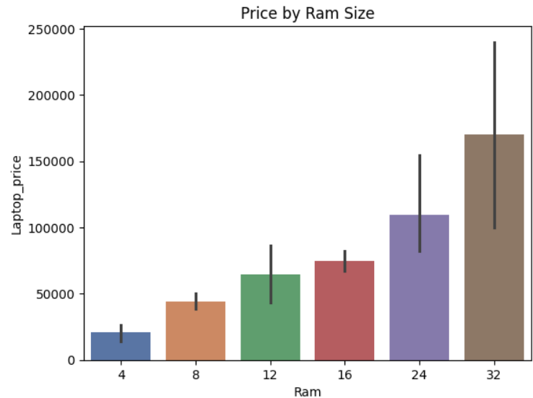
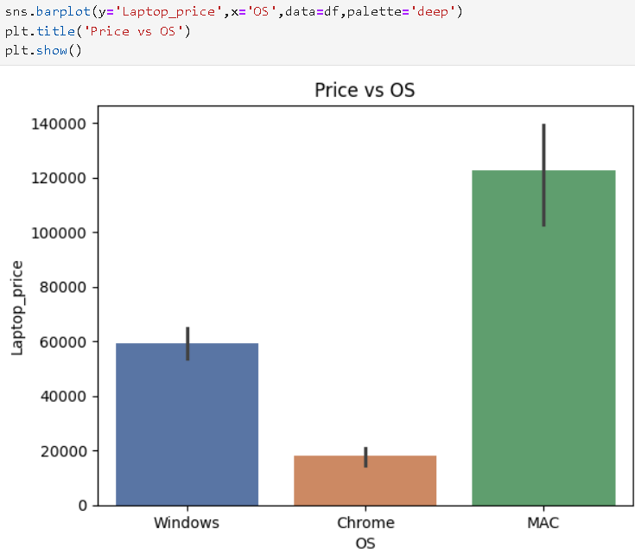
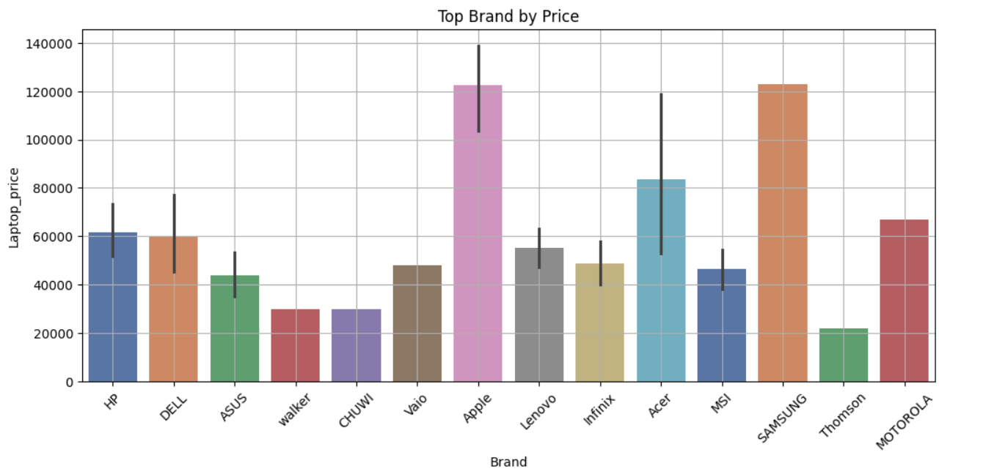
EDA

Slide 10
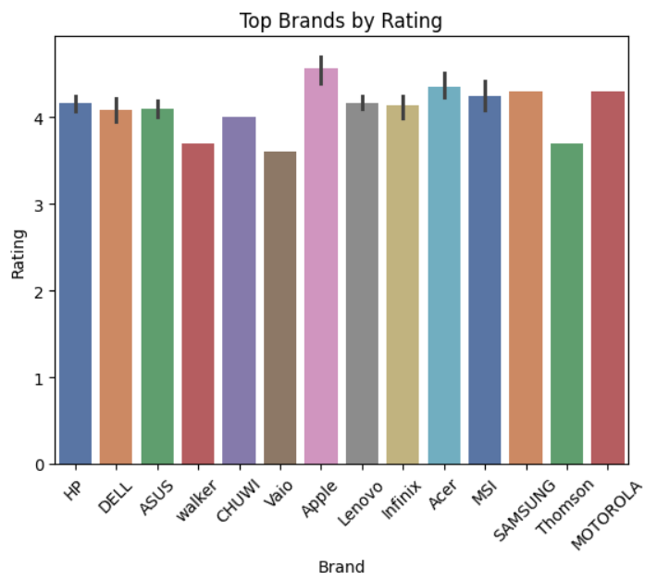
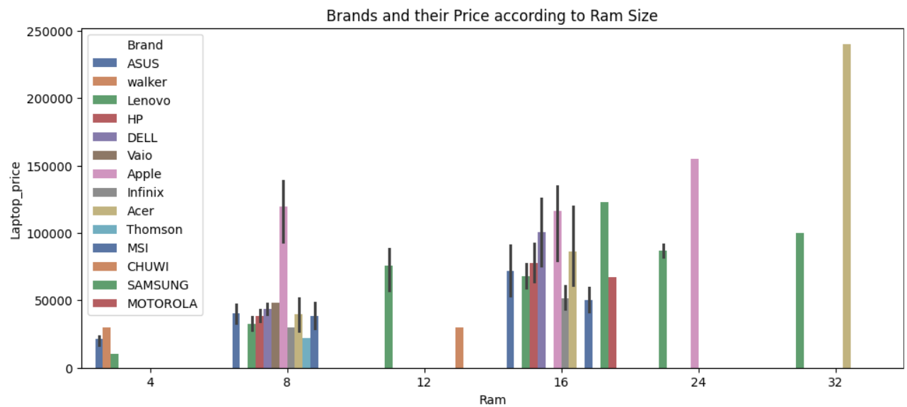
EDA

Slide 11
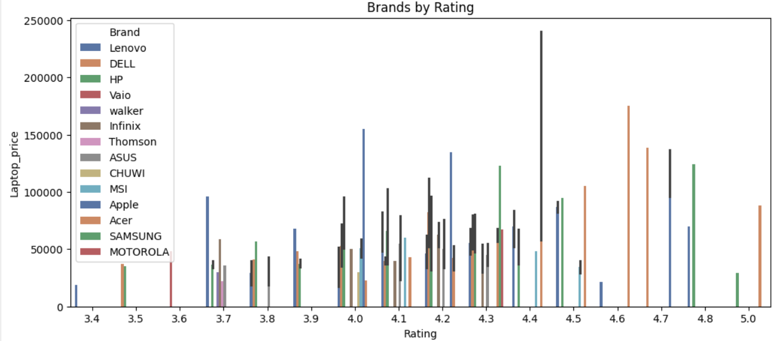
EDA

Slide 12
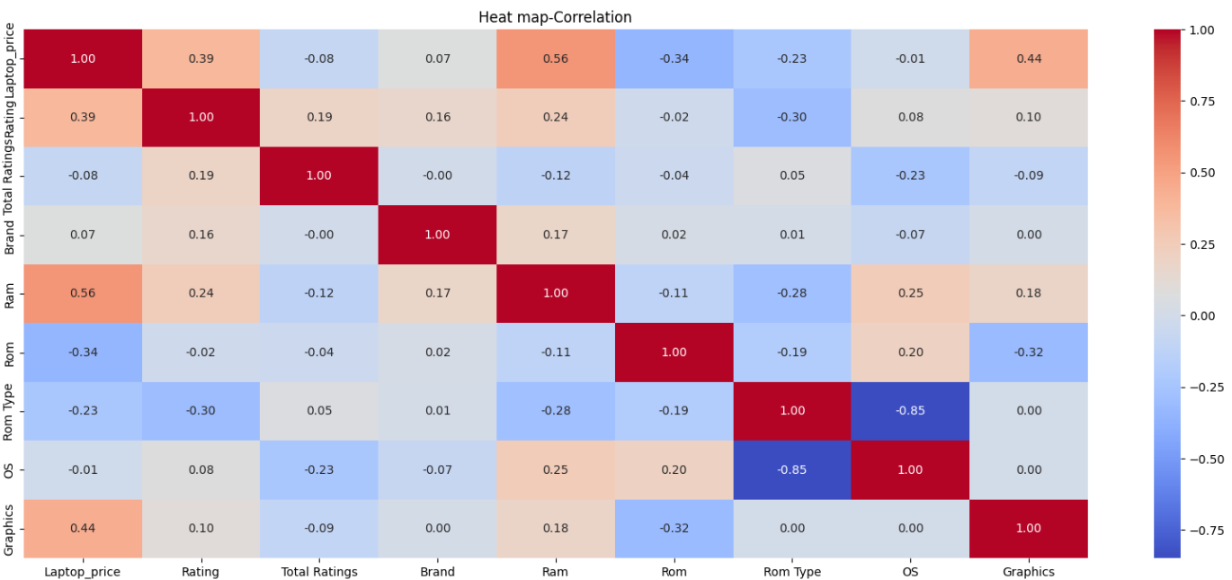
EDA

Slide 13
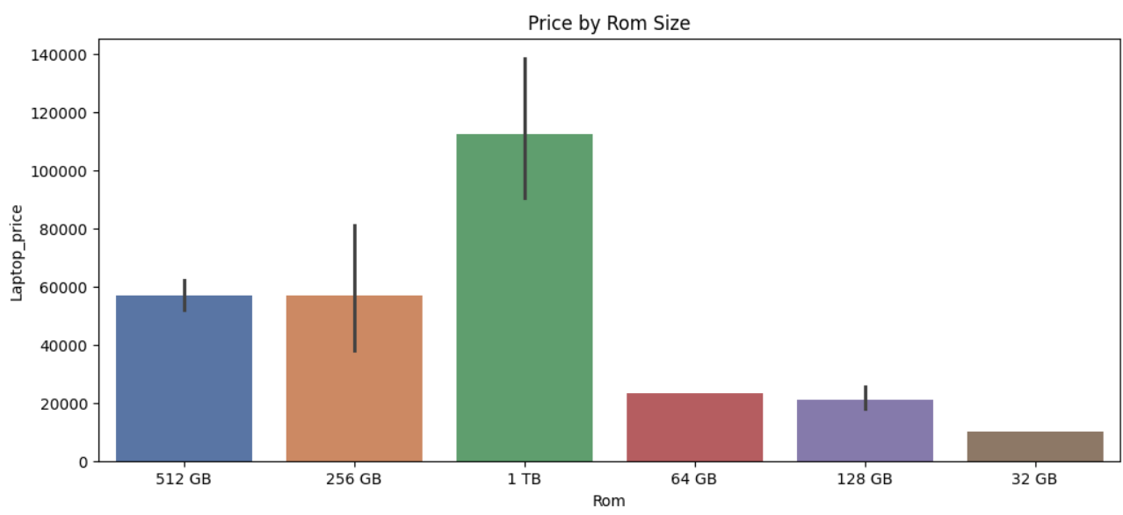
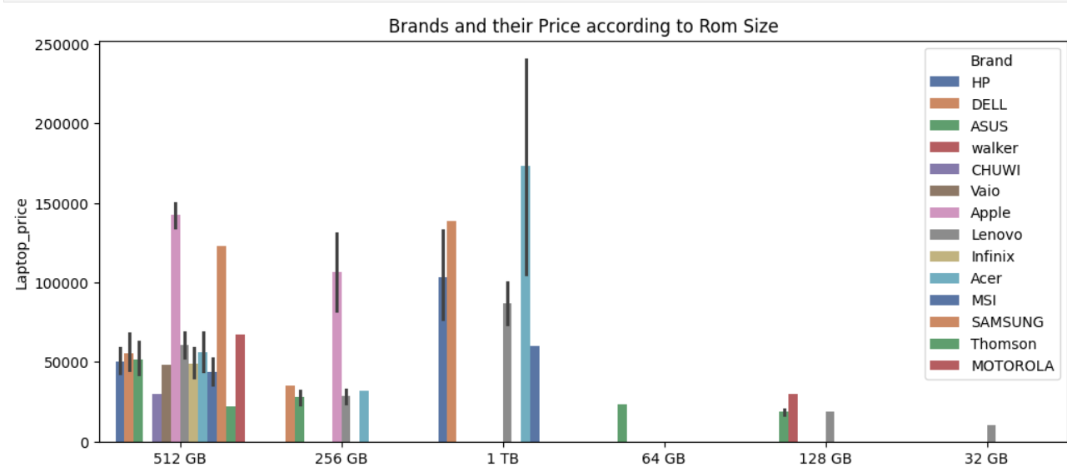
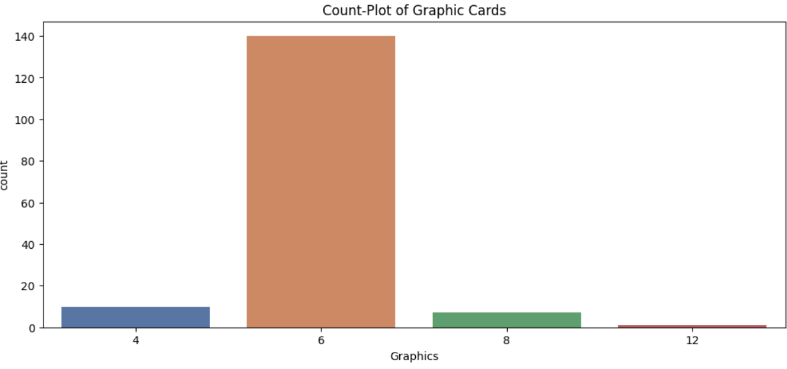
EDA

Slide 14
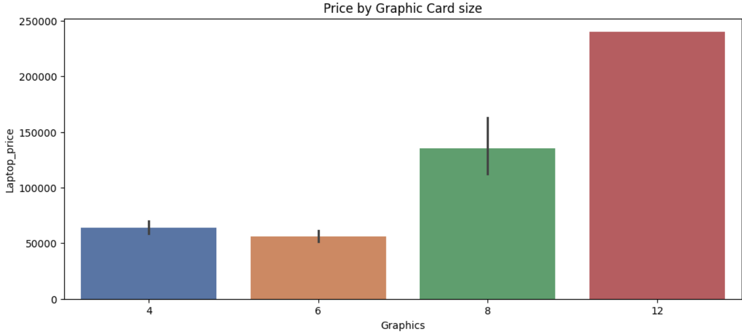
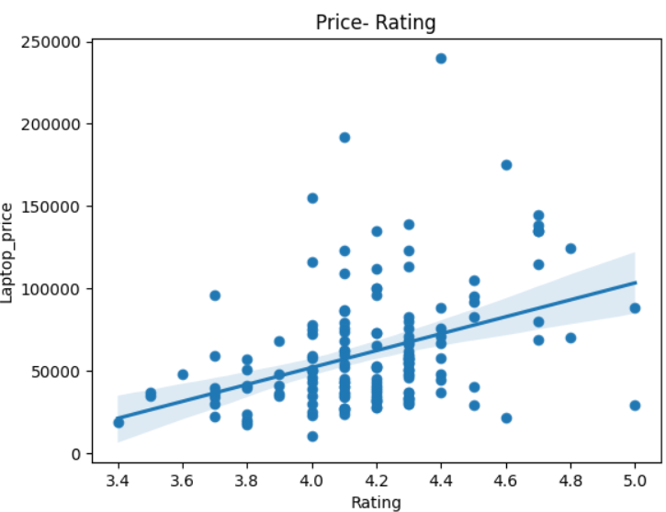
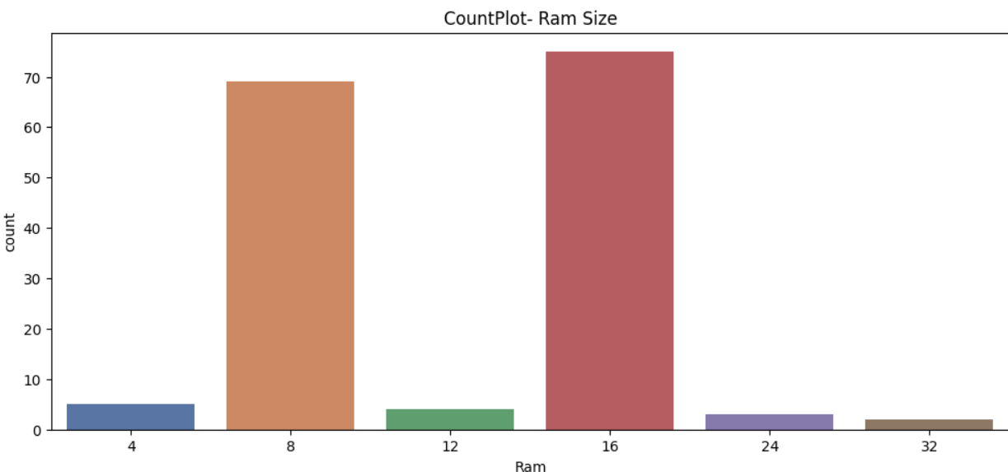
EDA

Slide 15
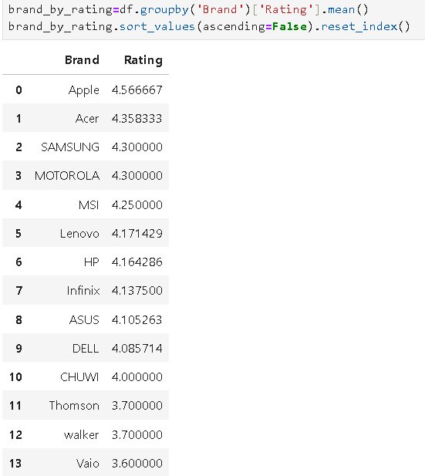
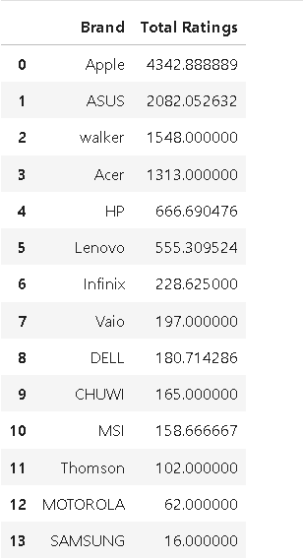
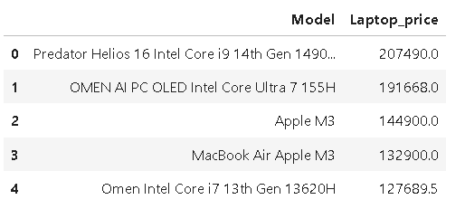
EDA

Slide 16
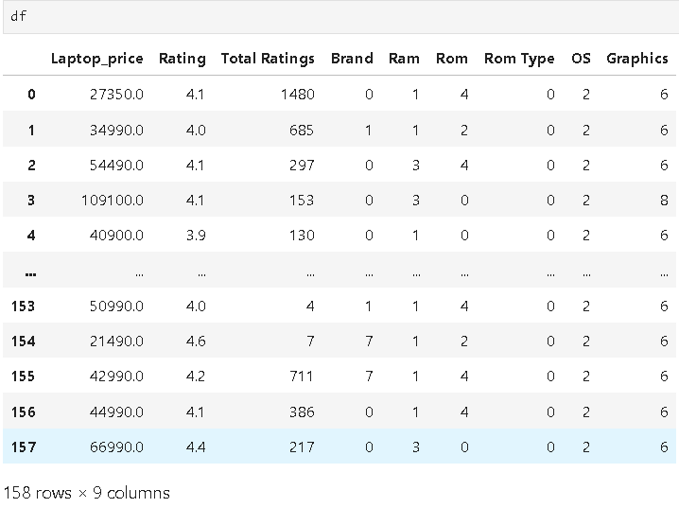
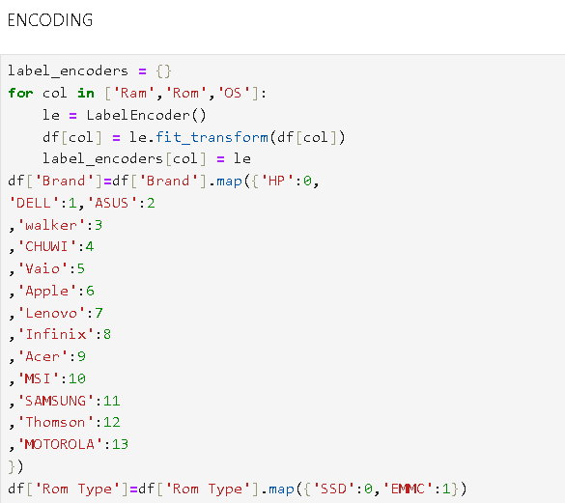
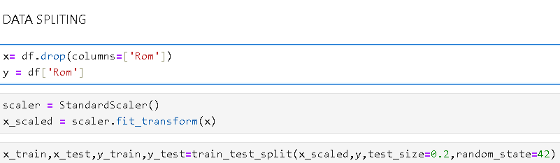
ENCODING

Slide 17
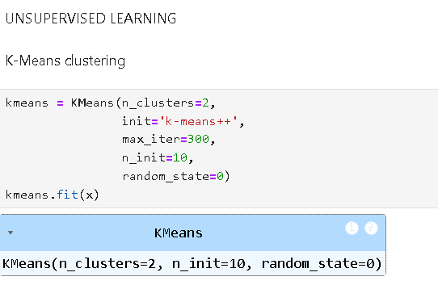
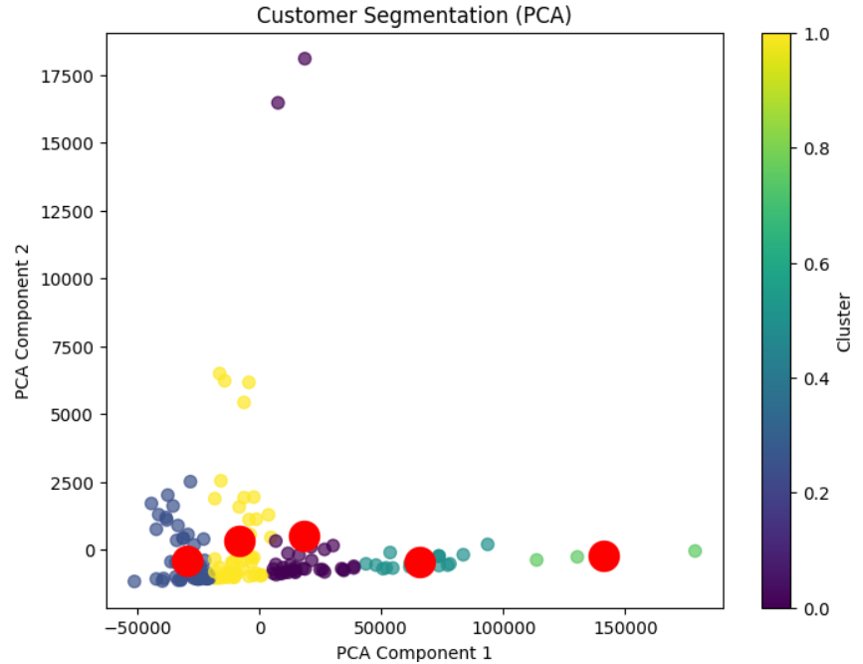
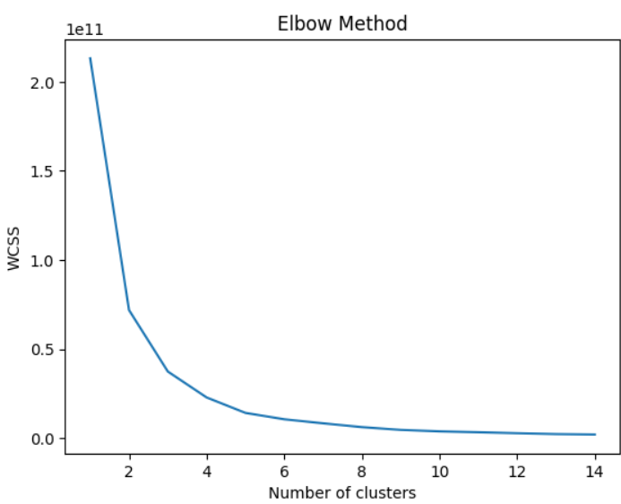
UNSUPERVISED LEARNING

Slide 18
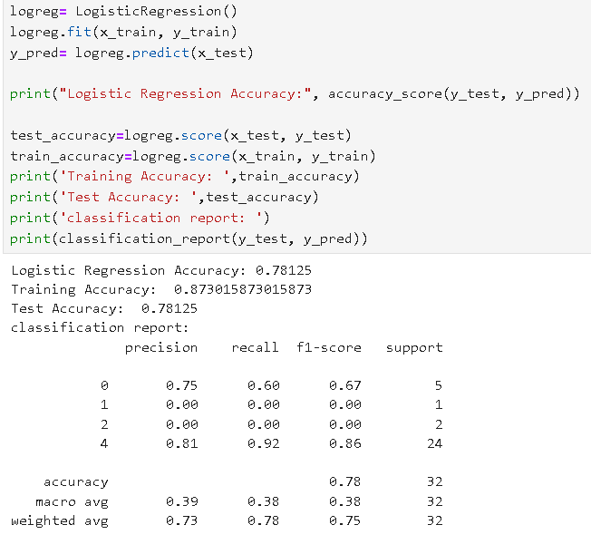
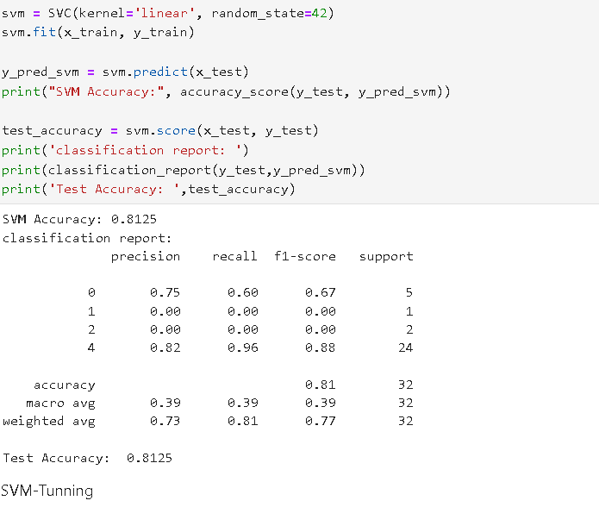
SUPERVISED LEARNING

Slide 19
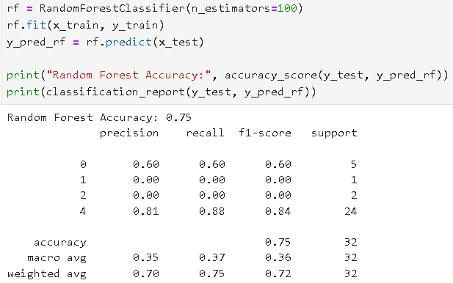
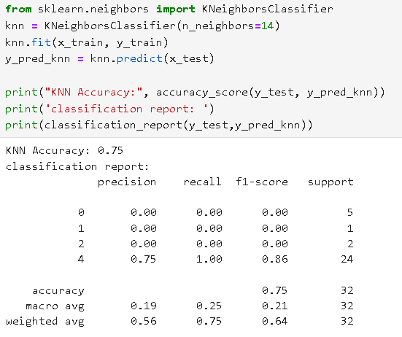
SUPERVISED LEARNING

Slide 20
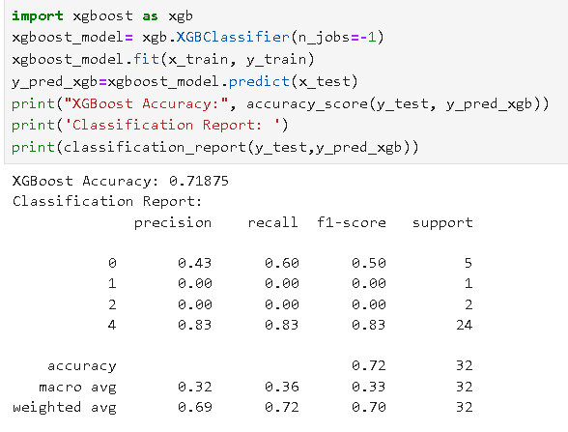
SUPERVISED LEARNING

Slide 21
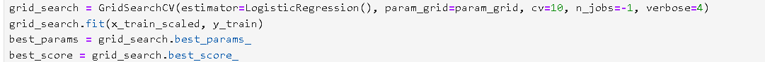
TUNNING

Slide 22
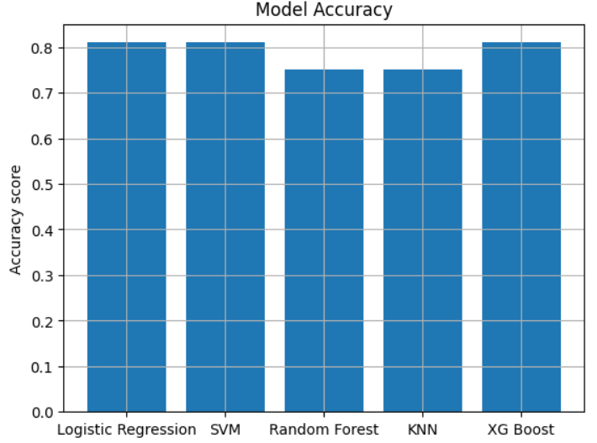
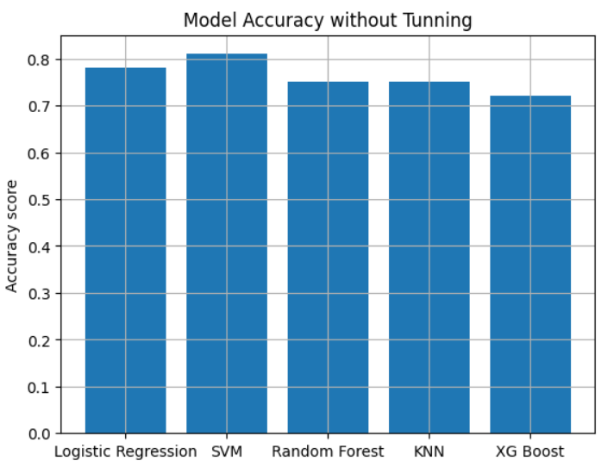
SUPERVISED LEARNING

Slide 23
BRANDS AND THEIR MODELS BY CUSTOMER RATING
BRAND | BEST MODEL | WORST MODEL
APPLE | 2020 MacBook Air Apple M1 | Apple M3
ACER | Nitro V Intel Core i7 13th Gen 13620H | Aspire 3 Intel Celeron Dual Core N4500
SAMSUNG | Galaxy Book5 360 AI PC Full Metal Chassis Intel | Galaxy Book5 360 AI PC Full Metal Chassis Intel
MOTOROLA | Motobook 60 Full Metal Intel Core 5 (Series 2) | Motobook 60 Full Metal Intel Core 5 (Series 2)
MSI | AMD Ryzen 5 Hexa Core 7530U | Intel Core i7 12th Gen 1255U
LENOVO | Legion Go AMD Ryzen Z1 Extreme | IdeaPad 3 Chrome Intel Celeron Dual Core N4500
HP | 15 G9 (2025) AMD Ryzen 3 Dual Core 3250U | 15R (2025) Intel Core i3 13th Gen 1315U
INFINIX | Y4 Max Series Intel Core i3 13th Gen 1315U | ZERO BOOK Series Laptop Intel Intel Core i7 12
ASUS | Vivobook 15, with Backlit Keyboard, Intel Core | Vivobook 15 Intel Core i3 13th Gen 1315U
DELL | G15 Intel Core i7 13th Gen 13650HX | G15 Intel Core i3 13th Gen 1305U
CHUVWI | Intel Core i3 12th Gen Intel Core i3(4) | Intel Core i3 12th Gen Intel Core i3(4)
THOMSON | NEO Core Series Intel Core i3 12th Gen 1215U | NEO Core Series Intel Core i3 12th Gen 1215U
WALKER | Intel Celeron Dual Core N4020 | Intel Celeron Dual Core N4020
VAIO | E Series AMD Ryzen 7 Quad Core 3700U | E Series AMD Ryzen 7 Quad Core 3700U

Slide 24
CONCLUSION
APPLE,ASUS,HP,ACER DOMINATE MARKET
PRICE –RAM-ROM CORRELATION
16GB-6GB-512GB BETTER
AVOID WALKER AND VAIO
BEST RATED APPLE
ACER,ASUS,MSI,HP MEDIUM BUDGET
LENOVO IN EVERY SIZE SEGMENT
SUGGESTED BUYS
DELL
ASUS
HP
ACER
MSI

